Slide 1

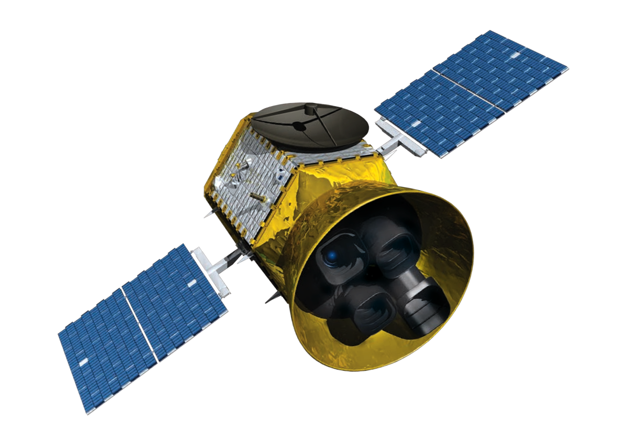
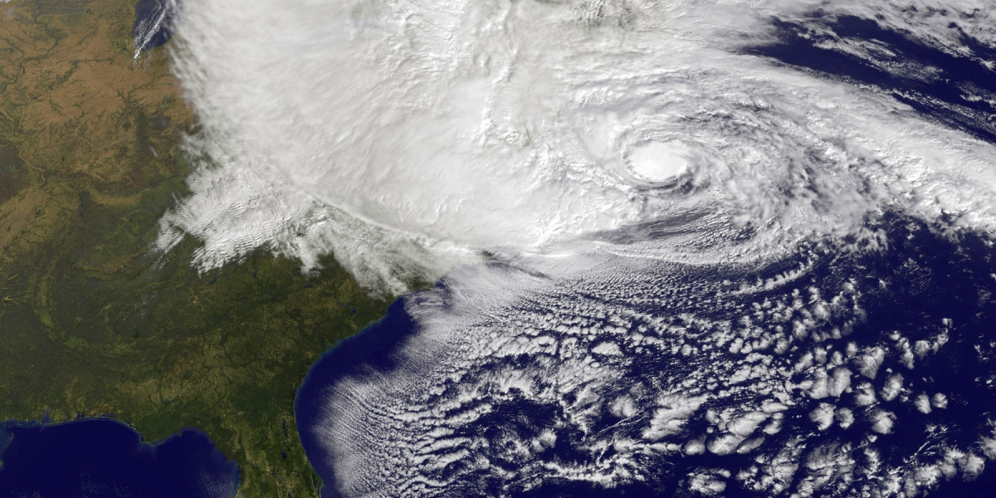
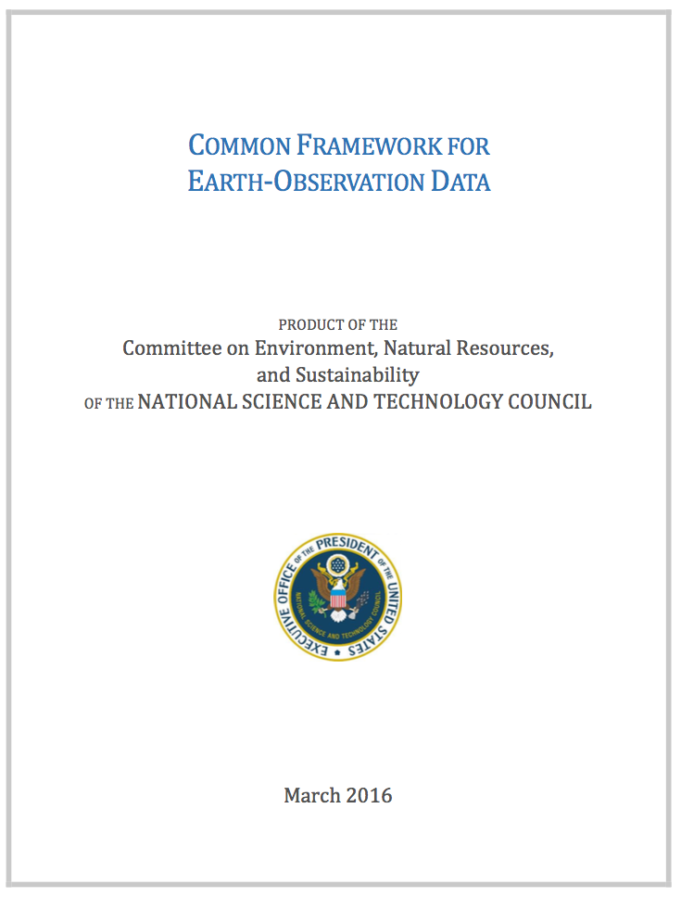

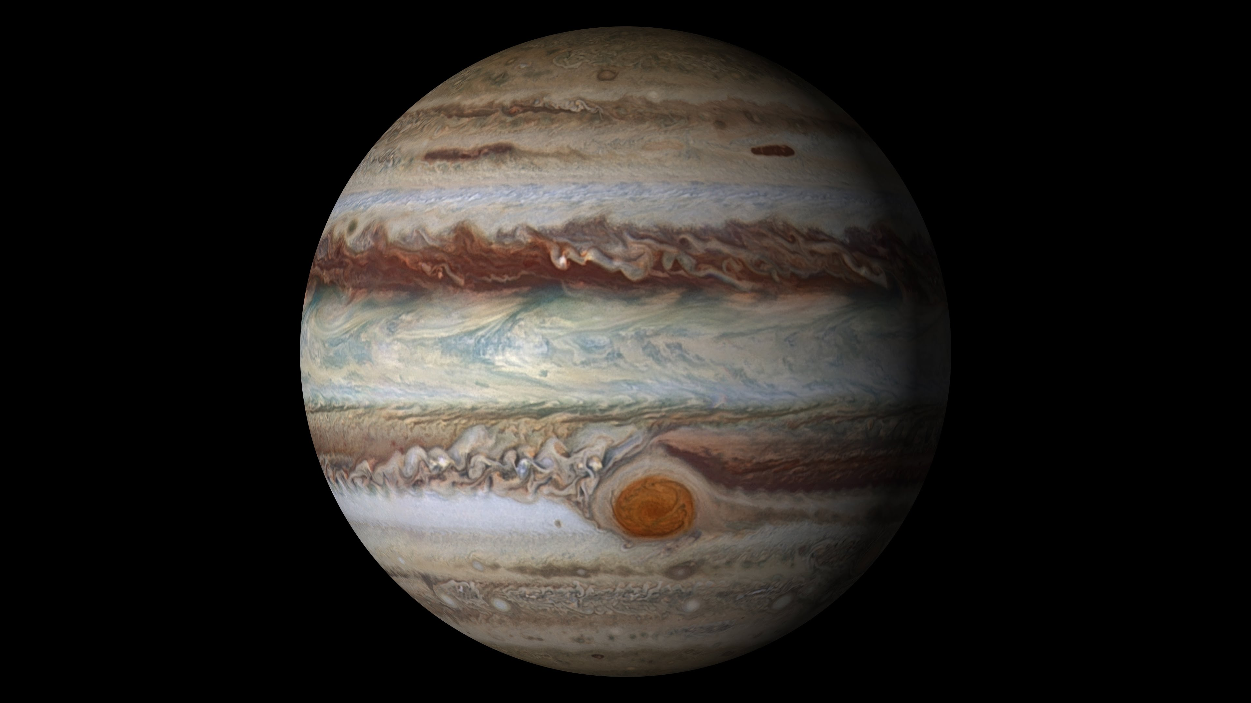


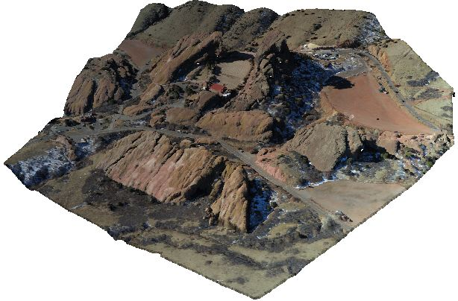

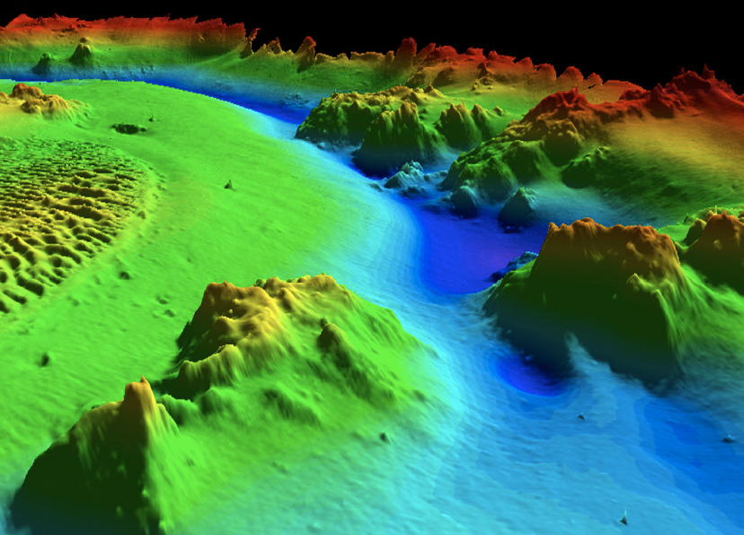
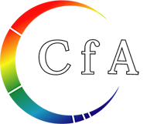

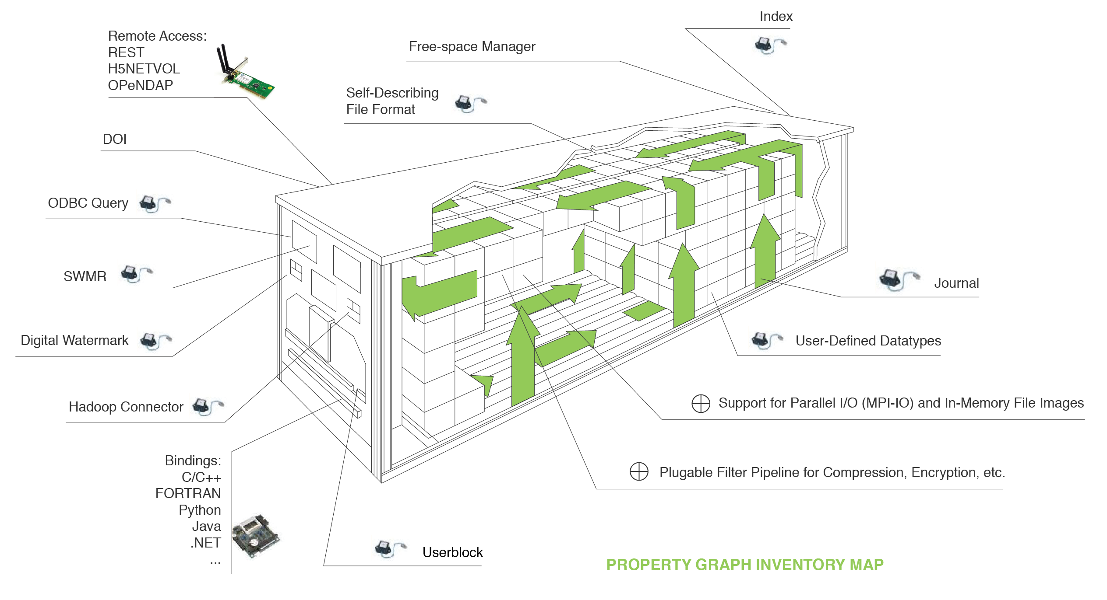
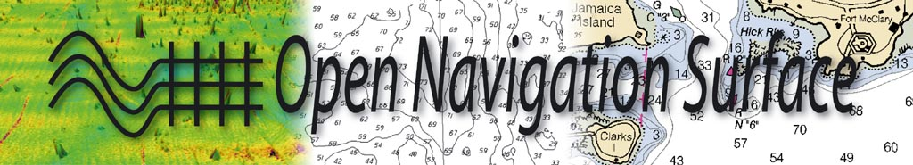
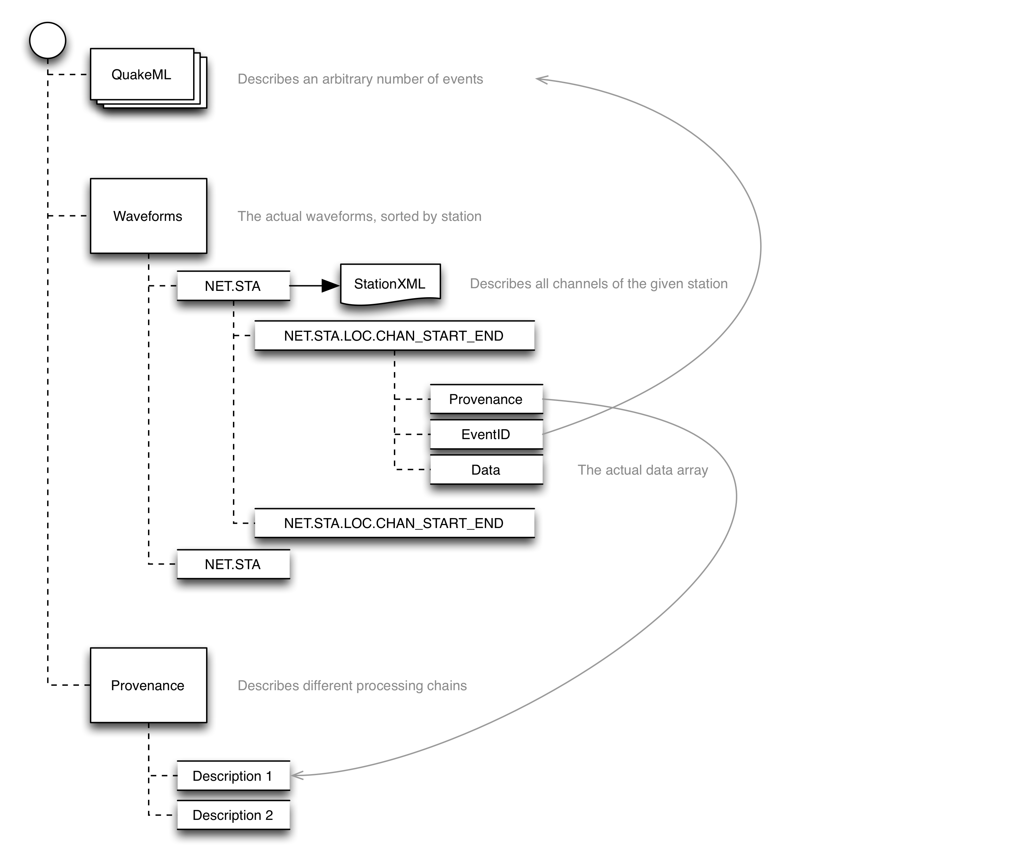
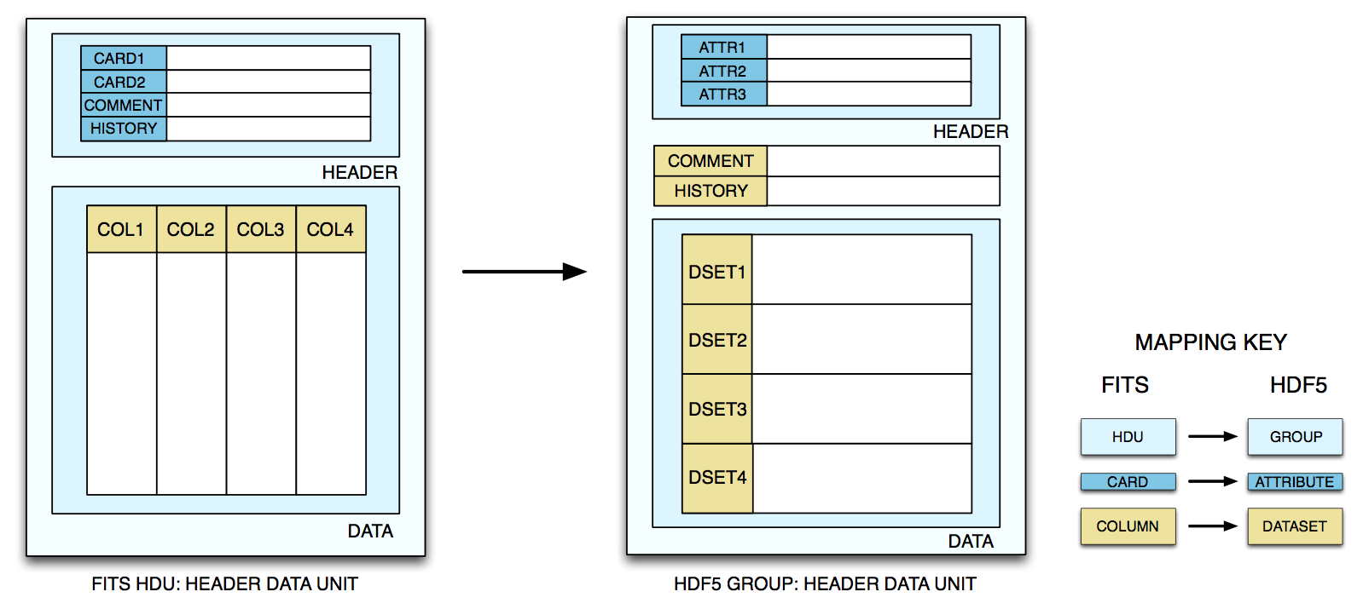
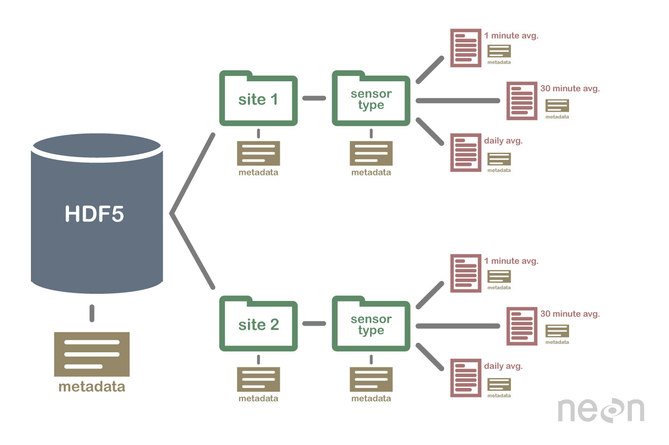
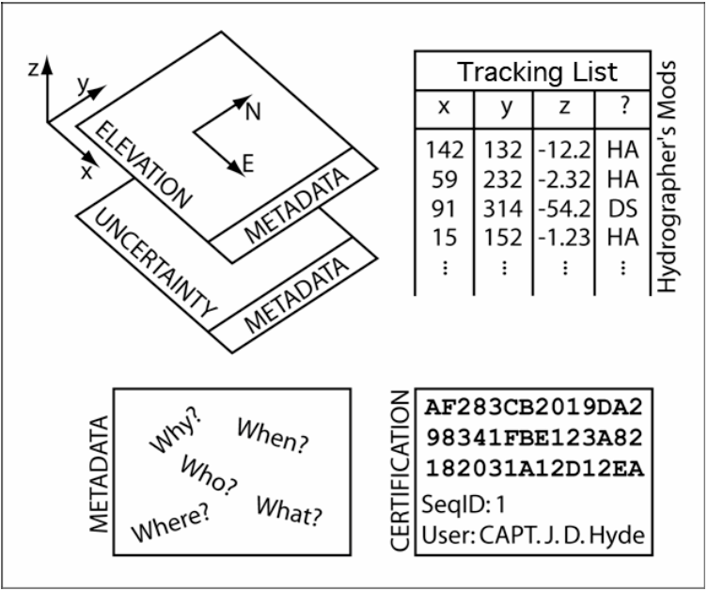
The HDF5 Data Format: High Performance Interoperability for Earth Science Communities
IN23C-1780
Sean Gordon (scgordon@hdfgroup.org), Ted Habermann, and John Kozimor, The HDF Group. Lindsay Powers, USGS
HDF5 is a high-performance information container available for many languages and computing platforms.
Communities customize HDF5 by creating conventions for metadata and data structures that are specific to their domains.
HDF5 is a standard foundation for storing, sharing, and reusing data from these communities.
Earth Observation
Atmospheric Science and Oceanography
Seismology
5.2.1 Data Formats
For numerical data:
NetCDF/HDF5 (Network Common Data Form, http://www.unidata.ucar.edu/software/netcdf). NetCDF4 used HDF5 (Hierarchical Data Format, http://www.hdfgroup.org/HDF5/) as its storage layer.
Planetary Science
HDF-EOS
Swaths
Multi-dimensional Grids
Zonal Averages
Points
NetCDF / CF
Multi-dimensional Grids
Discreet Sampling Features
Ecology
Seismic-Data
Harvard-Smithsonian Center for Astrophysics
Hydrography
ASDF
Station & Event Metadata
Waveforms
Provenance
FITSinHDF
Planetary and Solar
Imagery
NEON HDF5
Observation Time Series
Model Results
Point Clouds
BAG
Tabular metadata
Annotations
Grids
https://arxiv.org/abs/1505.06421
https://github.com/krischer/ASDF/wiki
http://www.neonscience.org
HDF5 Container: Capabilities and Future Directions.
http://www.opennavsurf.org
Notes:
Datatypes: Swaths, time, series grids. IDL
Common framework
Community conventions are important as they provide a convention to describe datatypes that are specific to their domain
Communities use hdf by creating metadata and data structure conventions describing datatypes that are specific to their domain
Communities customize HDF by creating metadata and data structure conventions for describing datatypes that are specific to their domain
Add qcode poster number
Consider adding matlab is a tool that uses hdf as a format .mat wrapper around hdf

